Slide 1
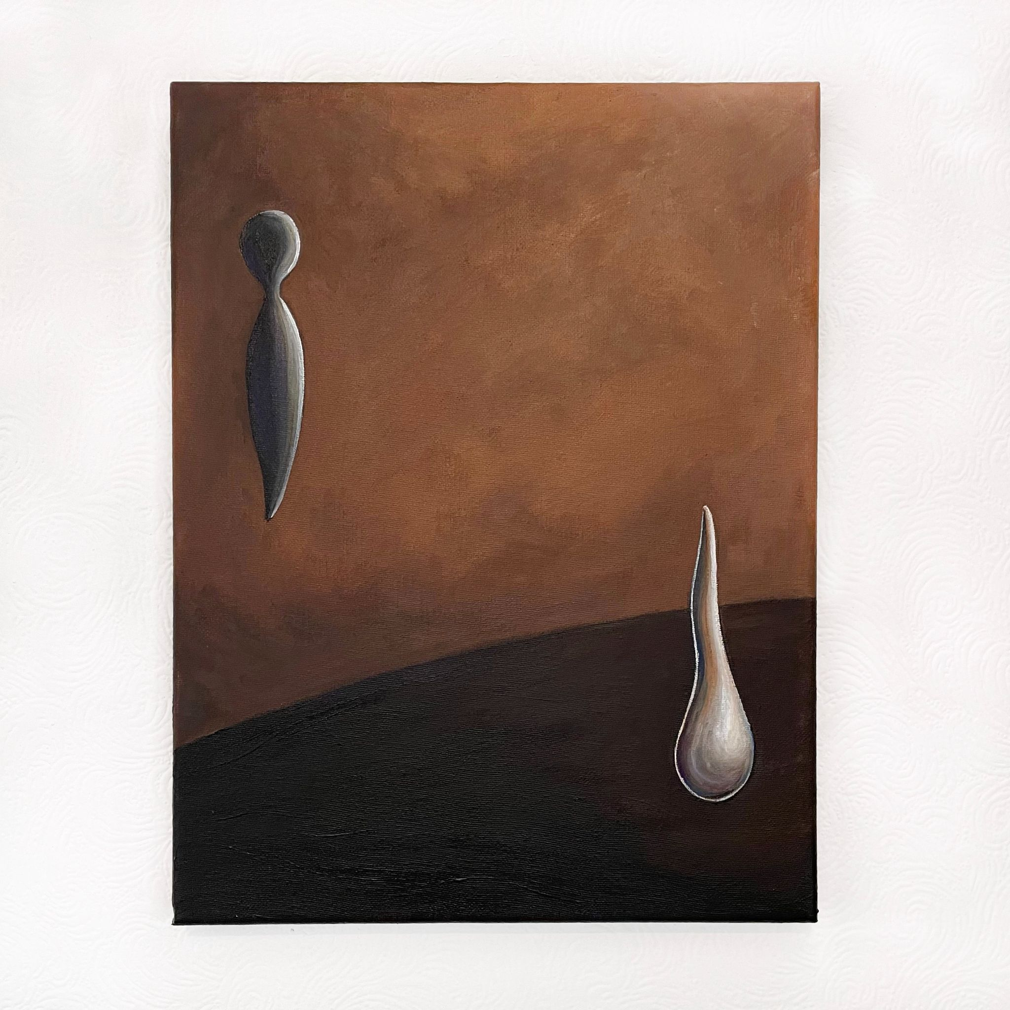
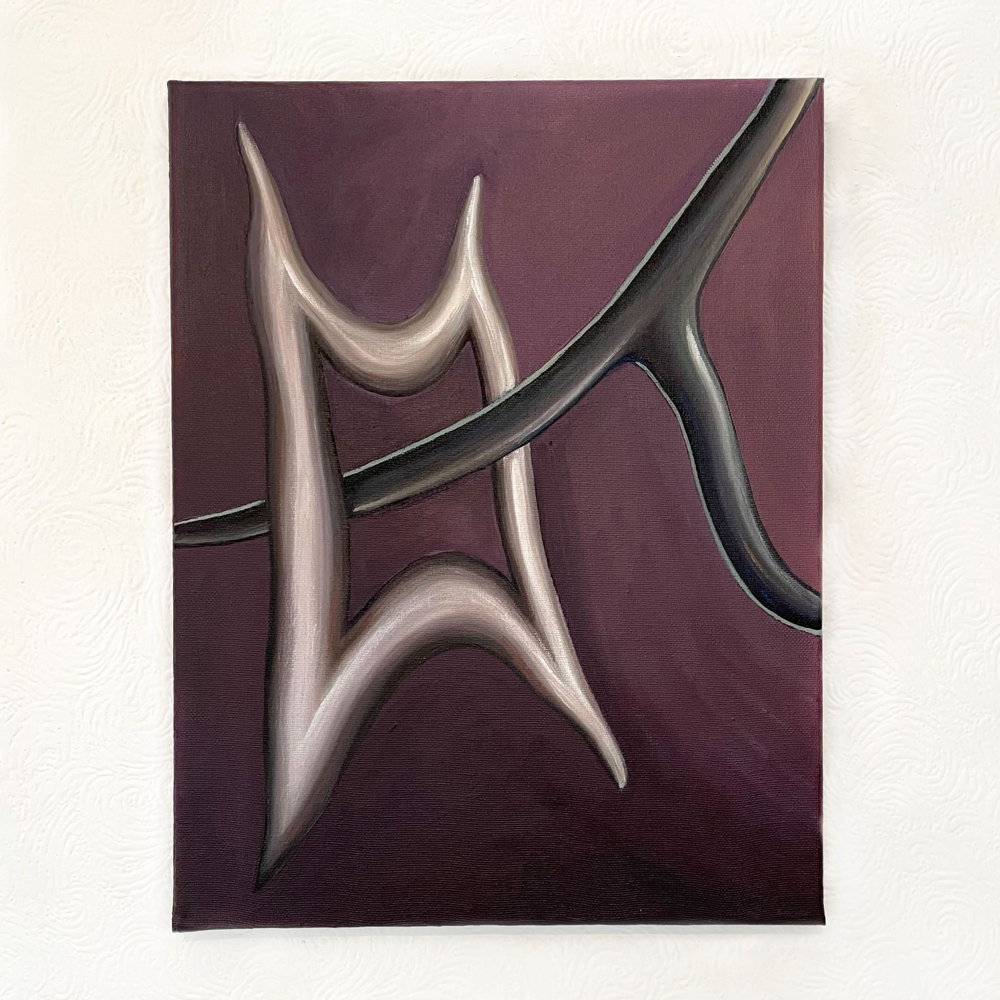
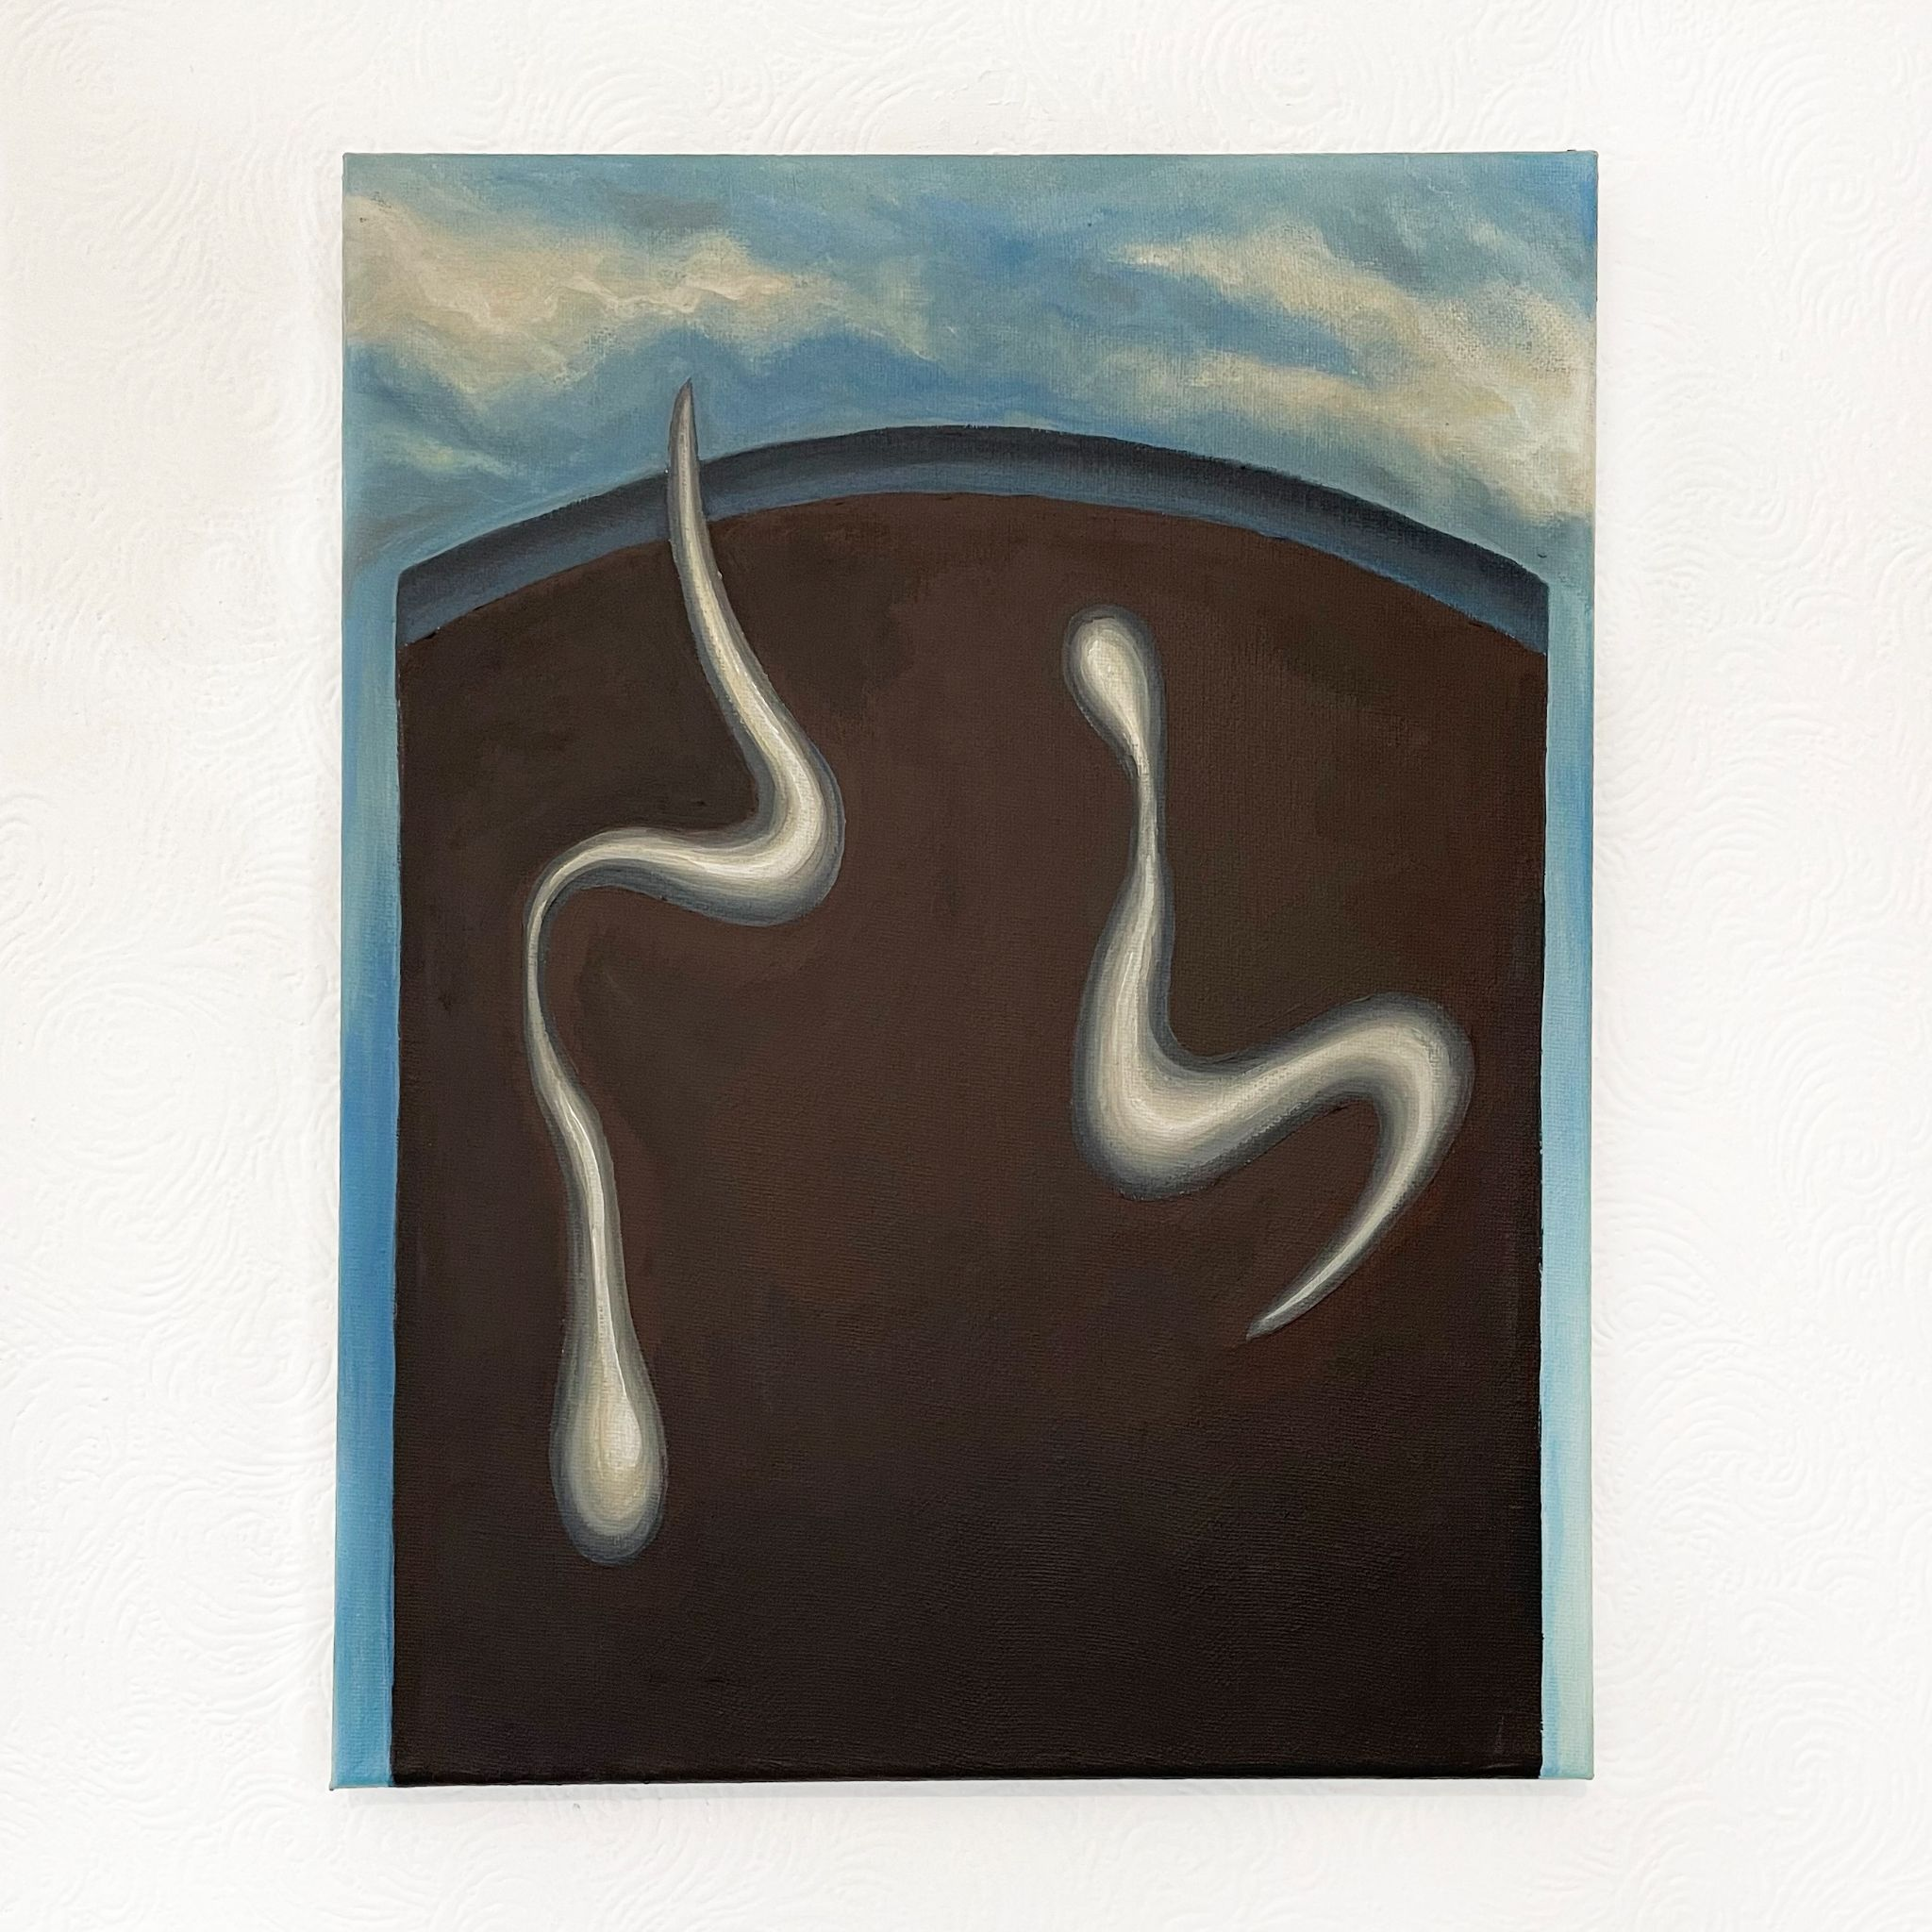
Study for Portrait of Hong Kong, 2021
Acrylic on canvas
350x270mm
Adieu, 2021
Acrylic on canvas
350x270mm
Elegy, 2021
Acrylic on canvas
350x270mm

Slide 2
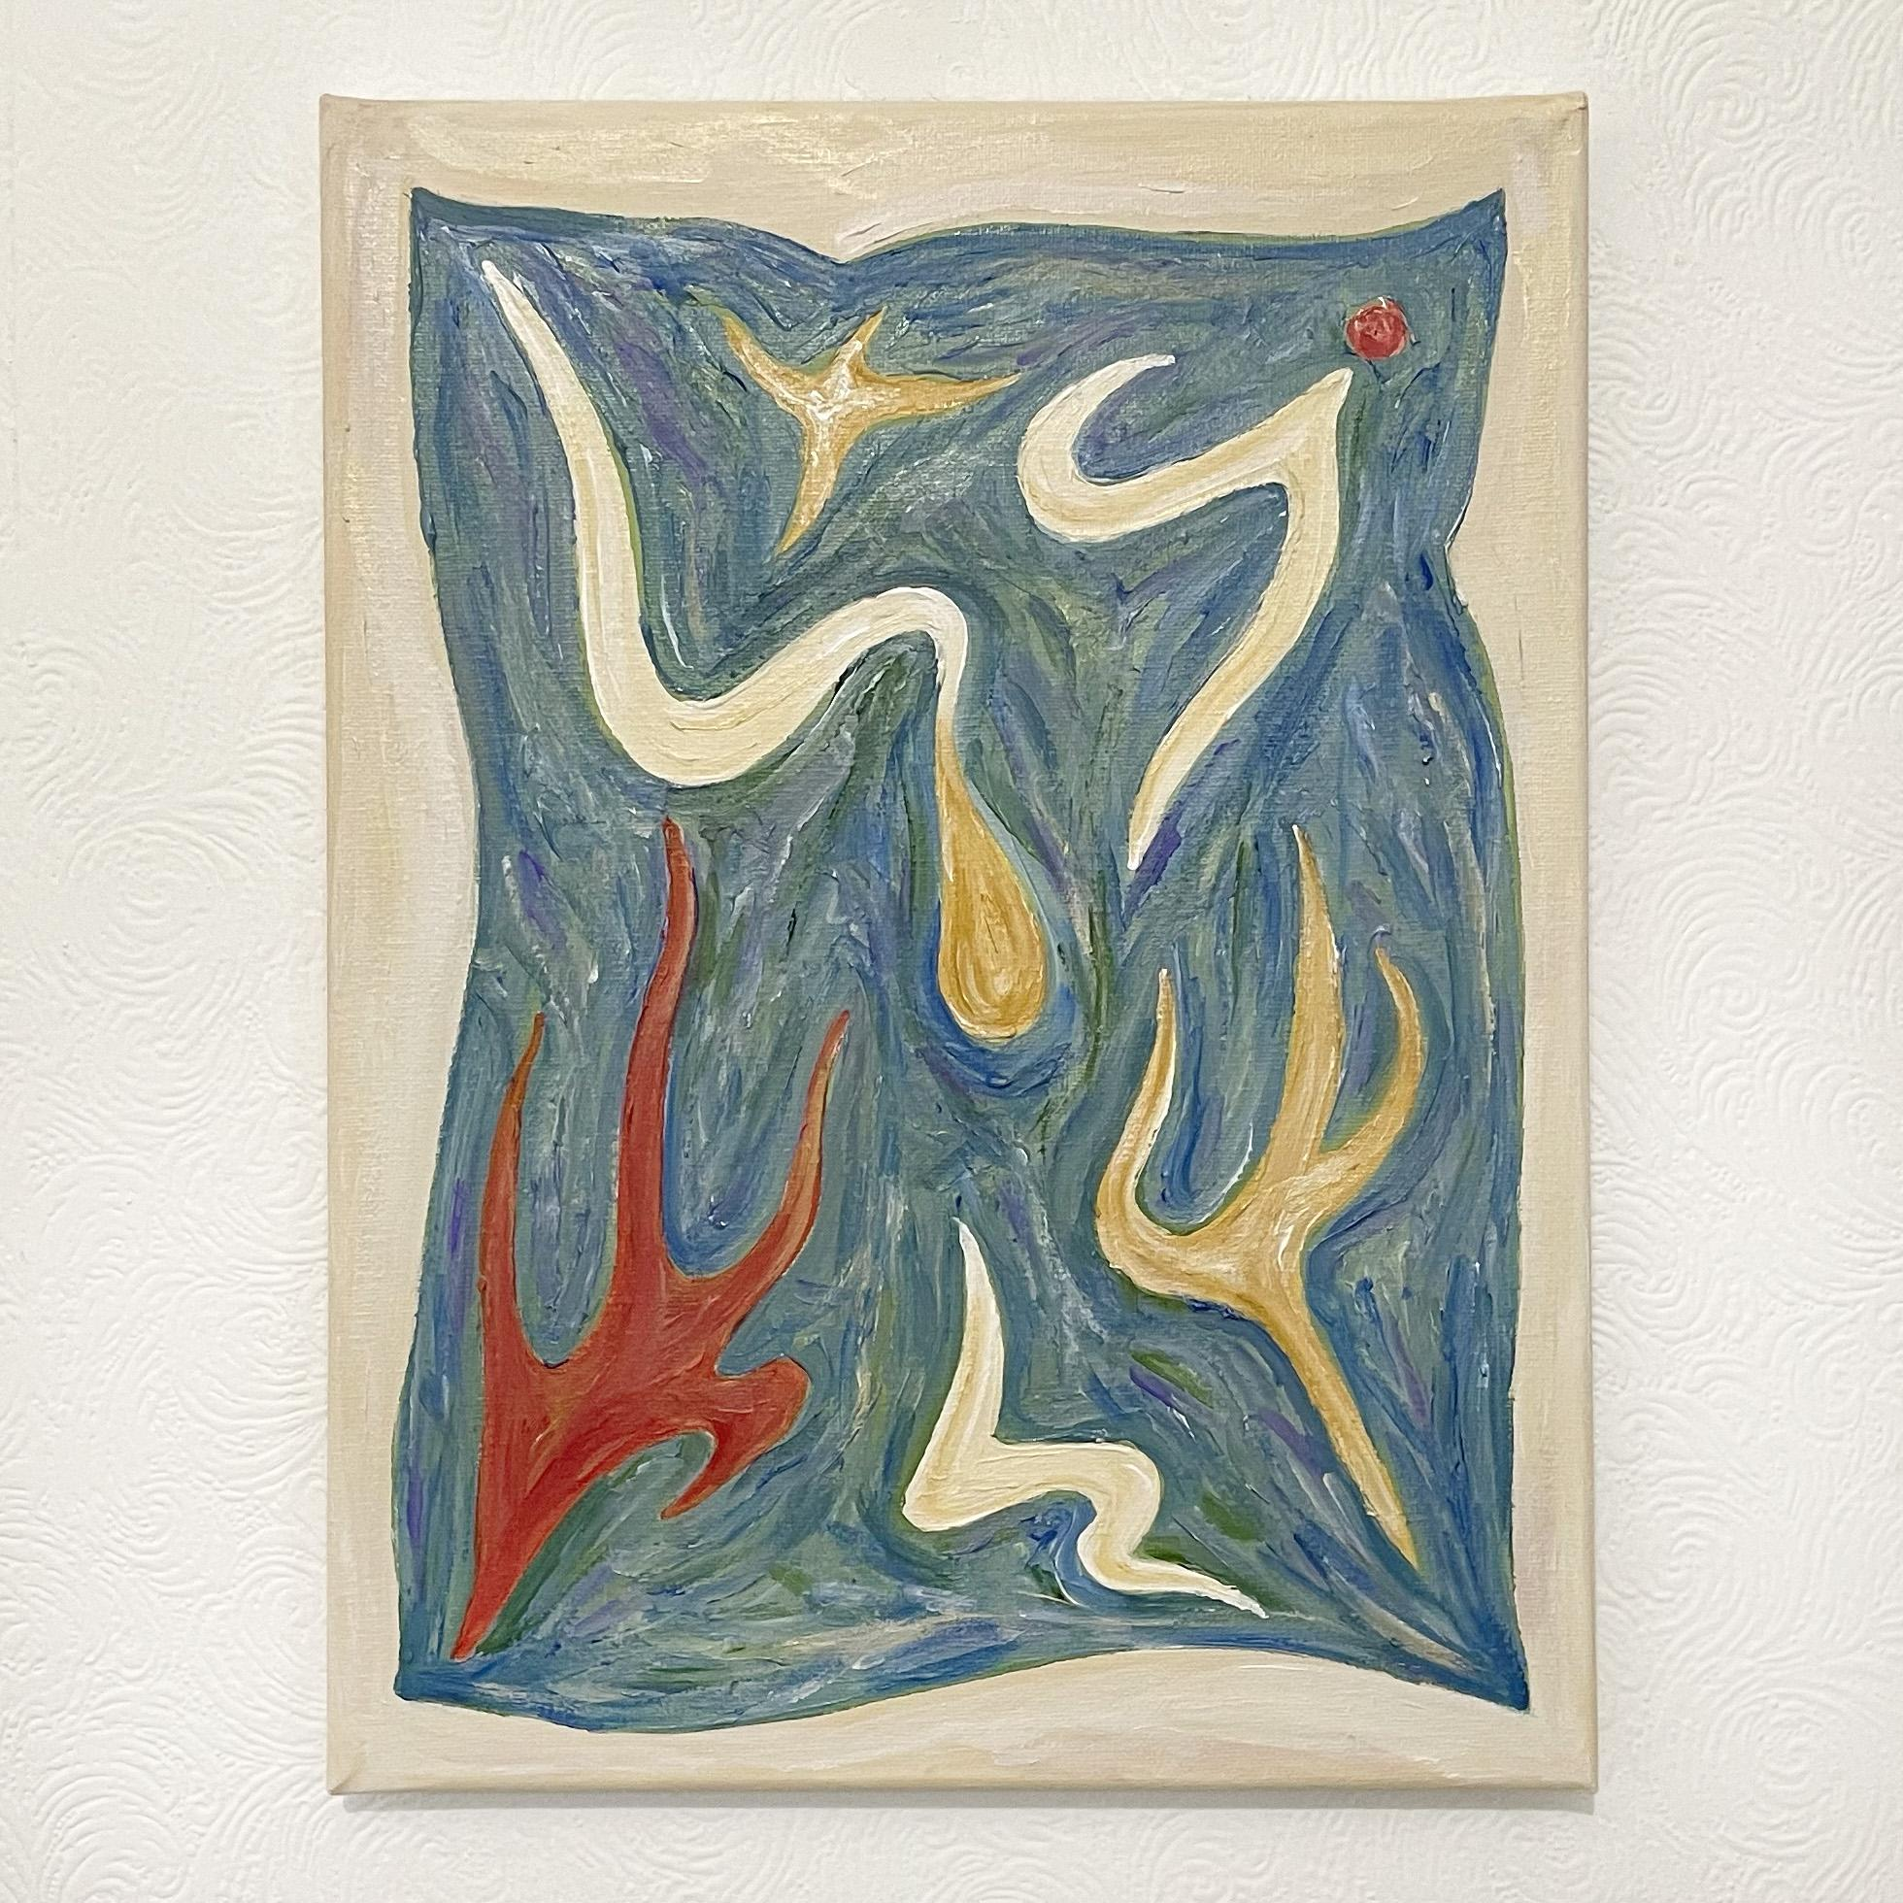
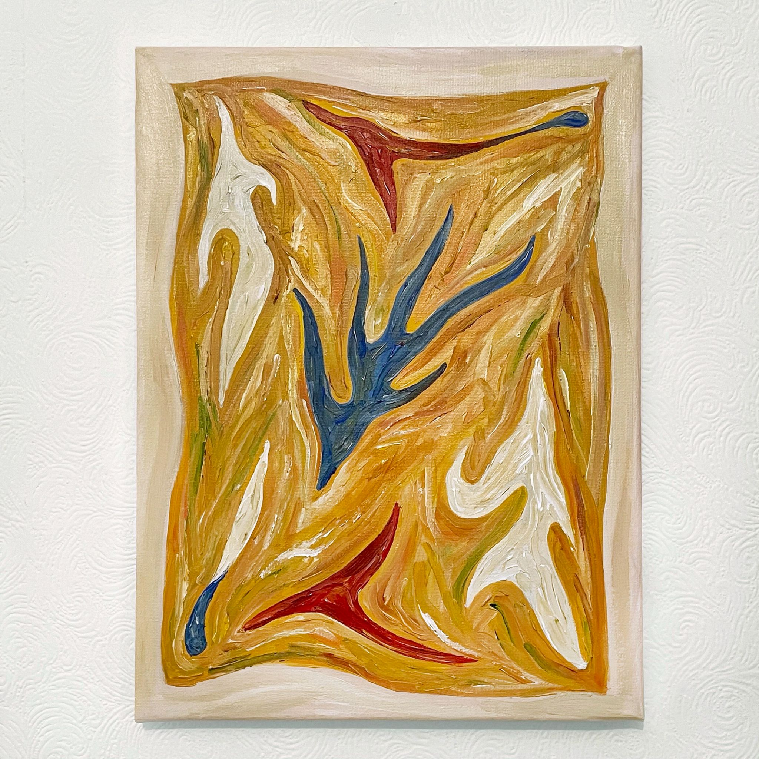
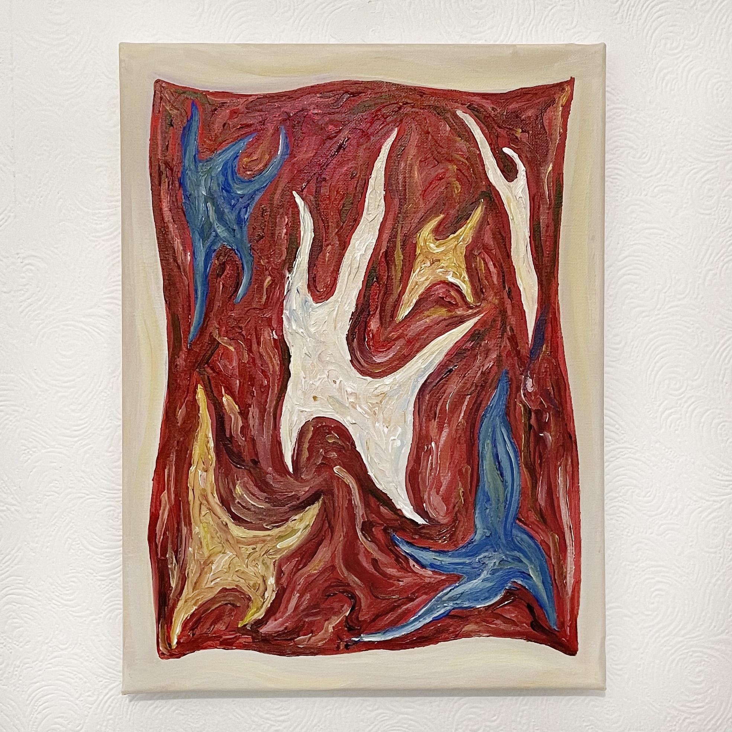
Untitled, 2021
Acrylic on canvas
350x270mm
Untitled, 2021
Acrylic on canvas
350x270mm
Untitled, 2021
Acrylic on canvas
350x270mm

Slide 3
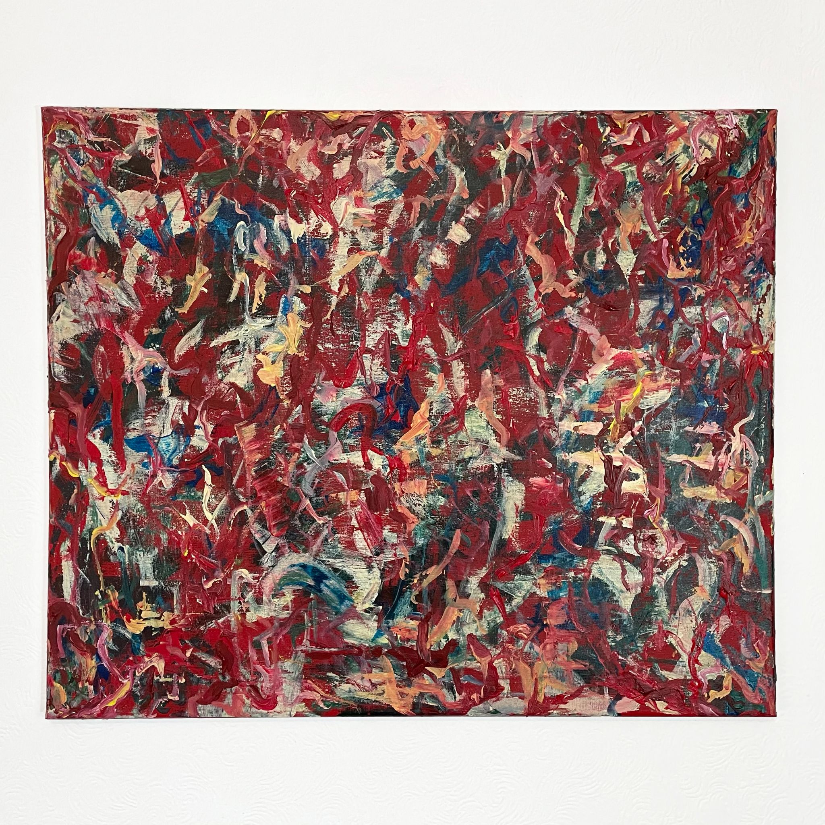
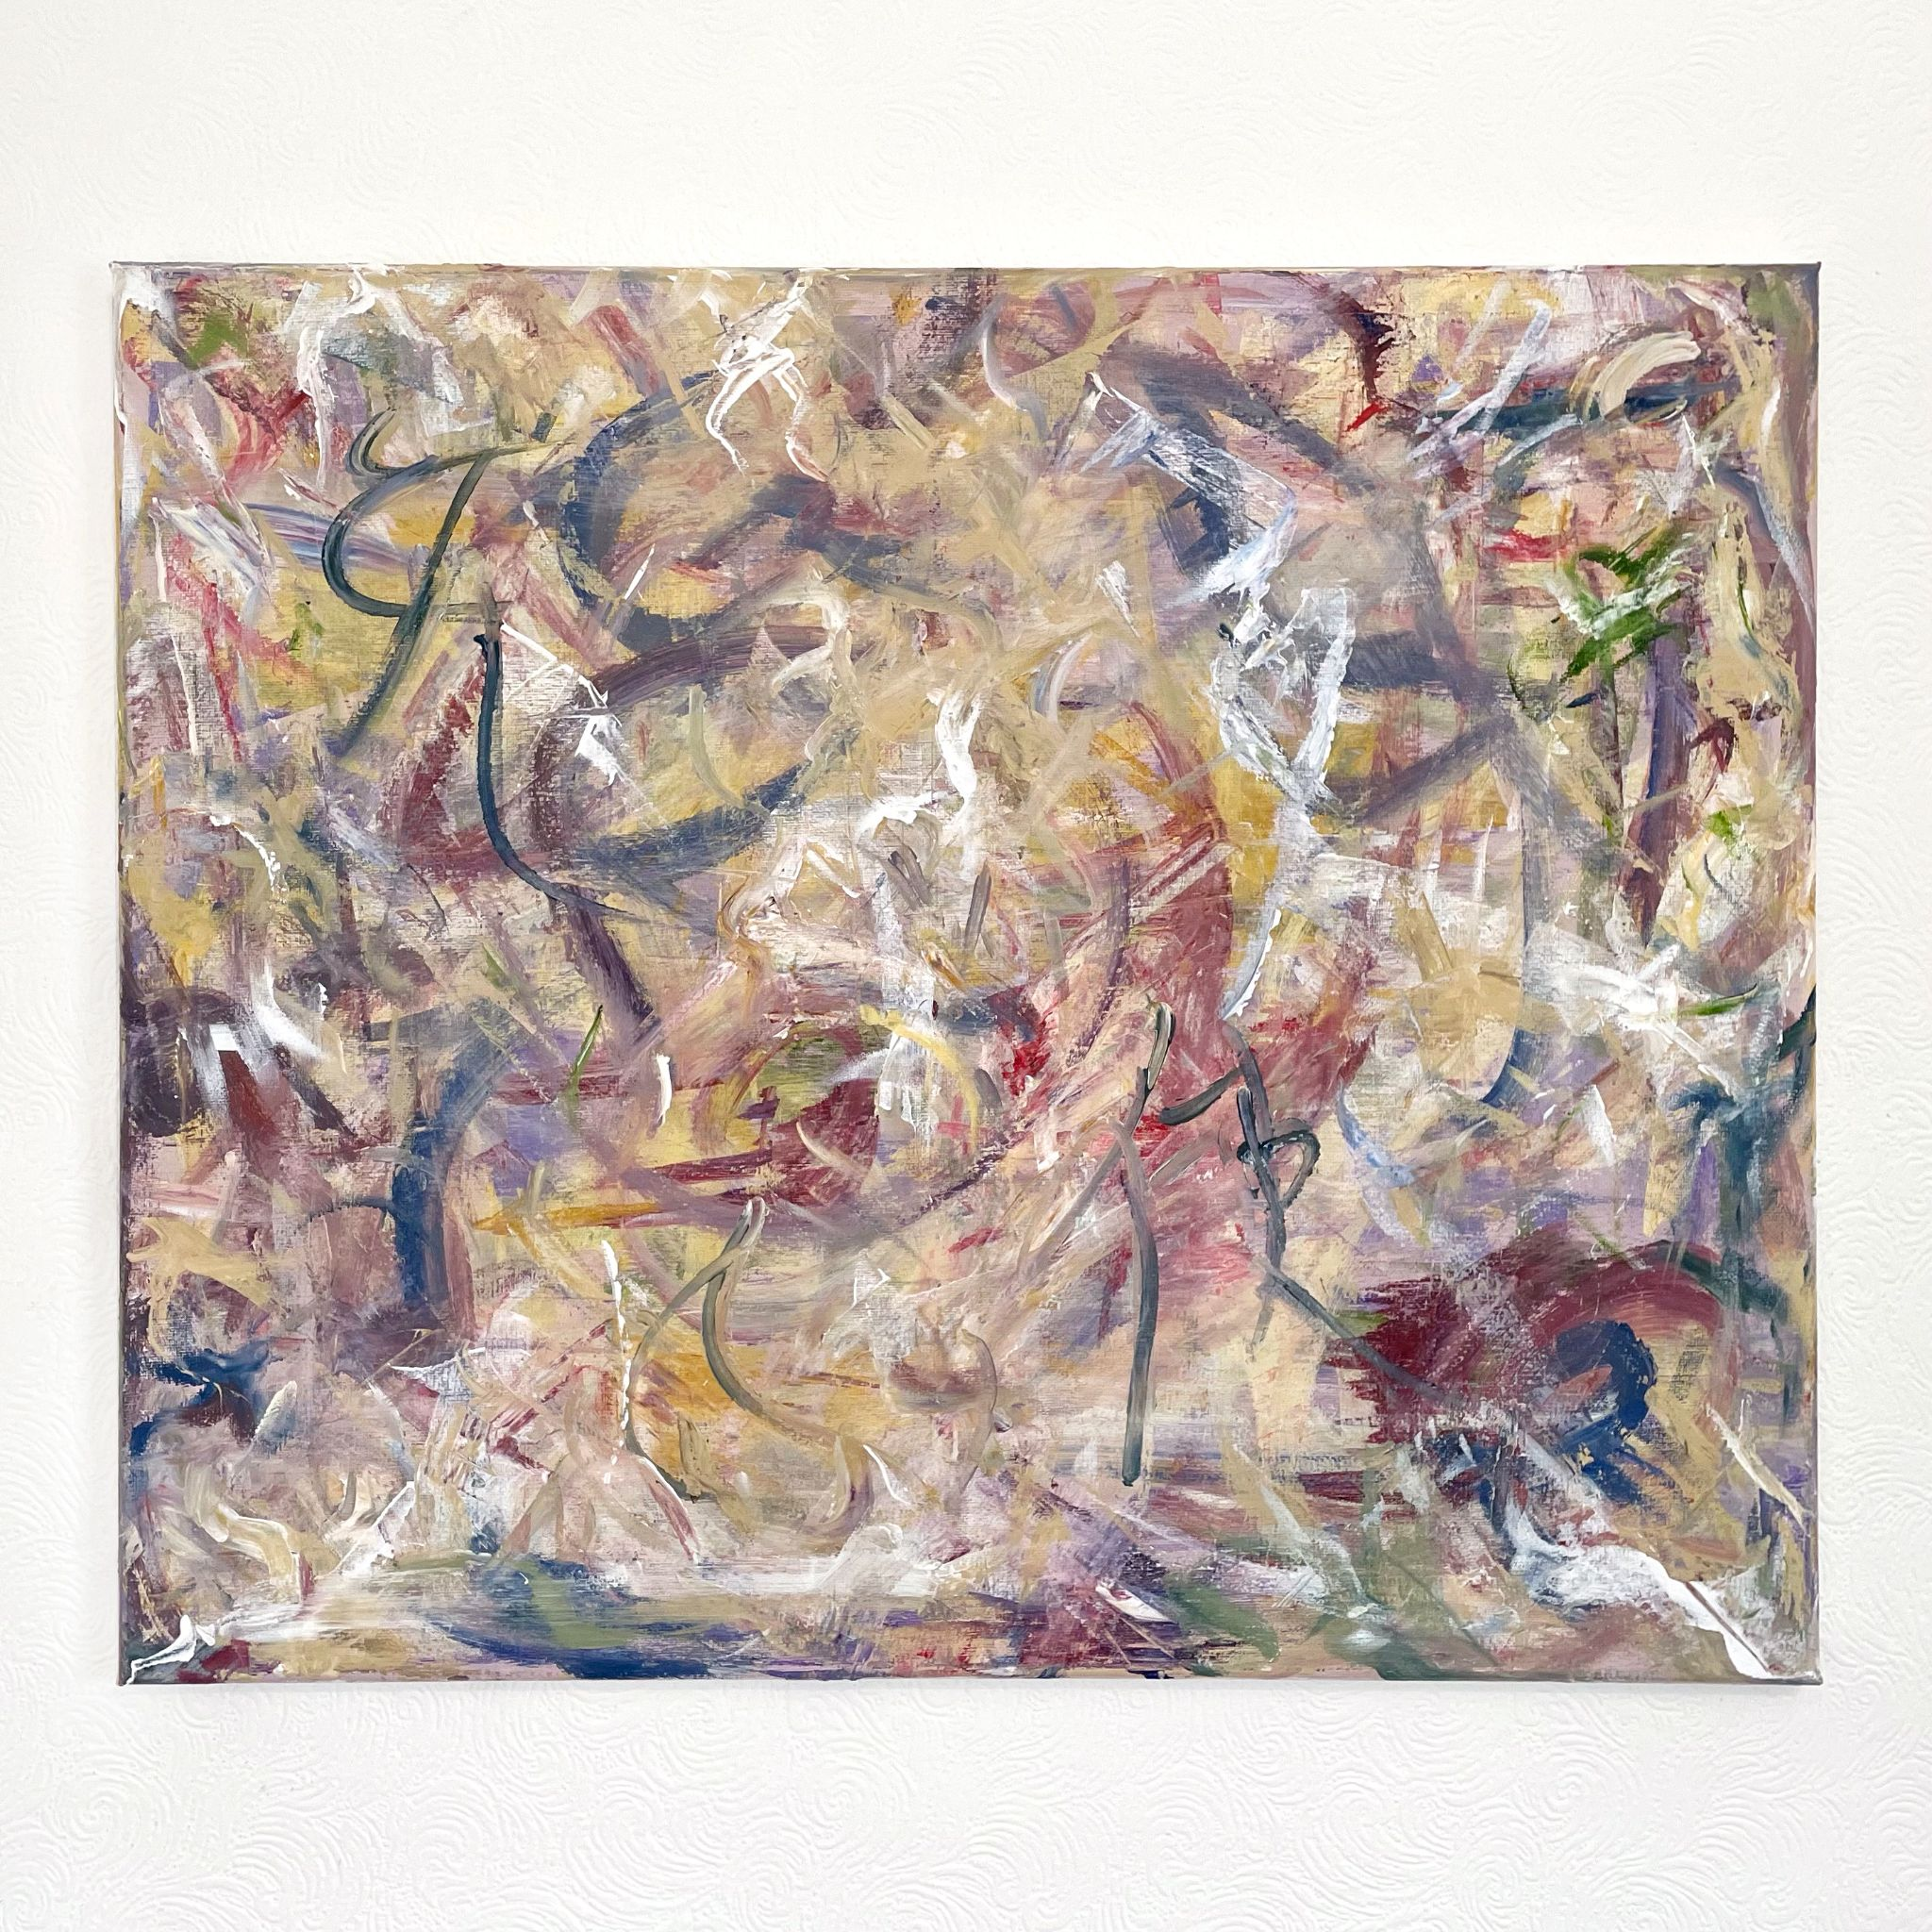
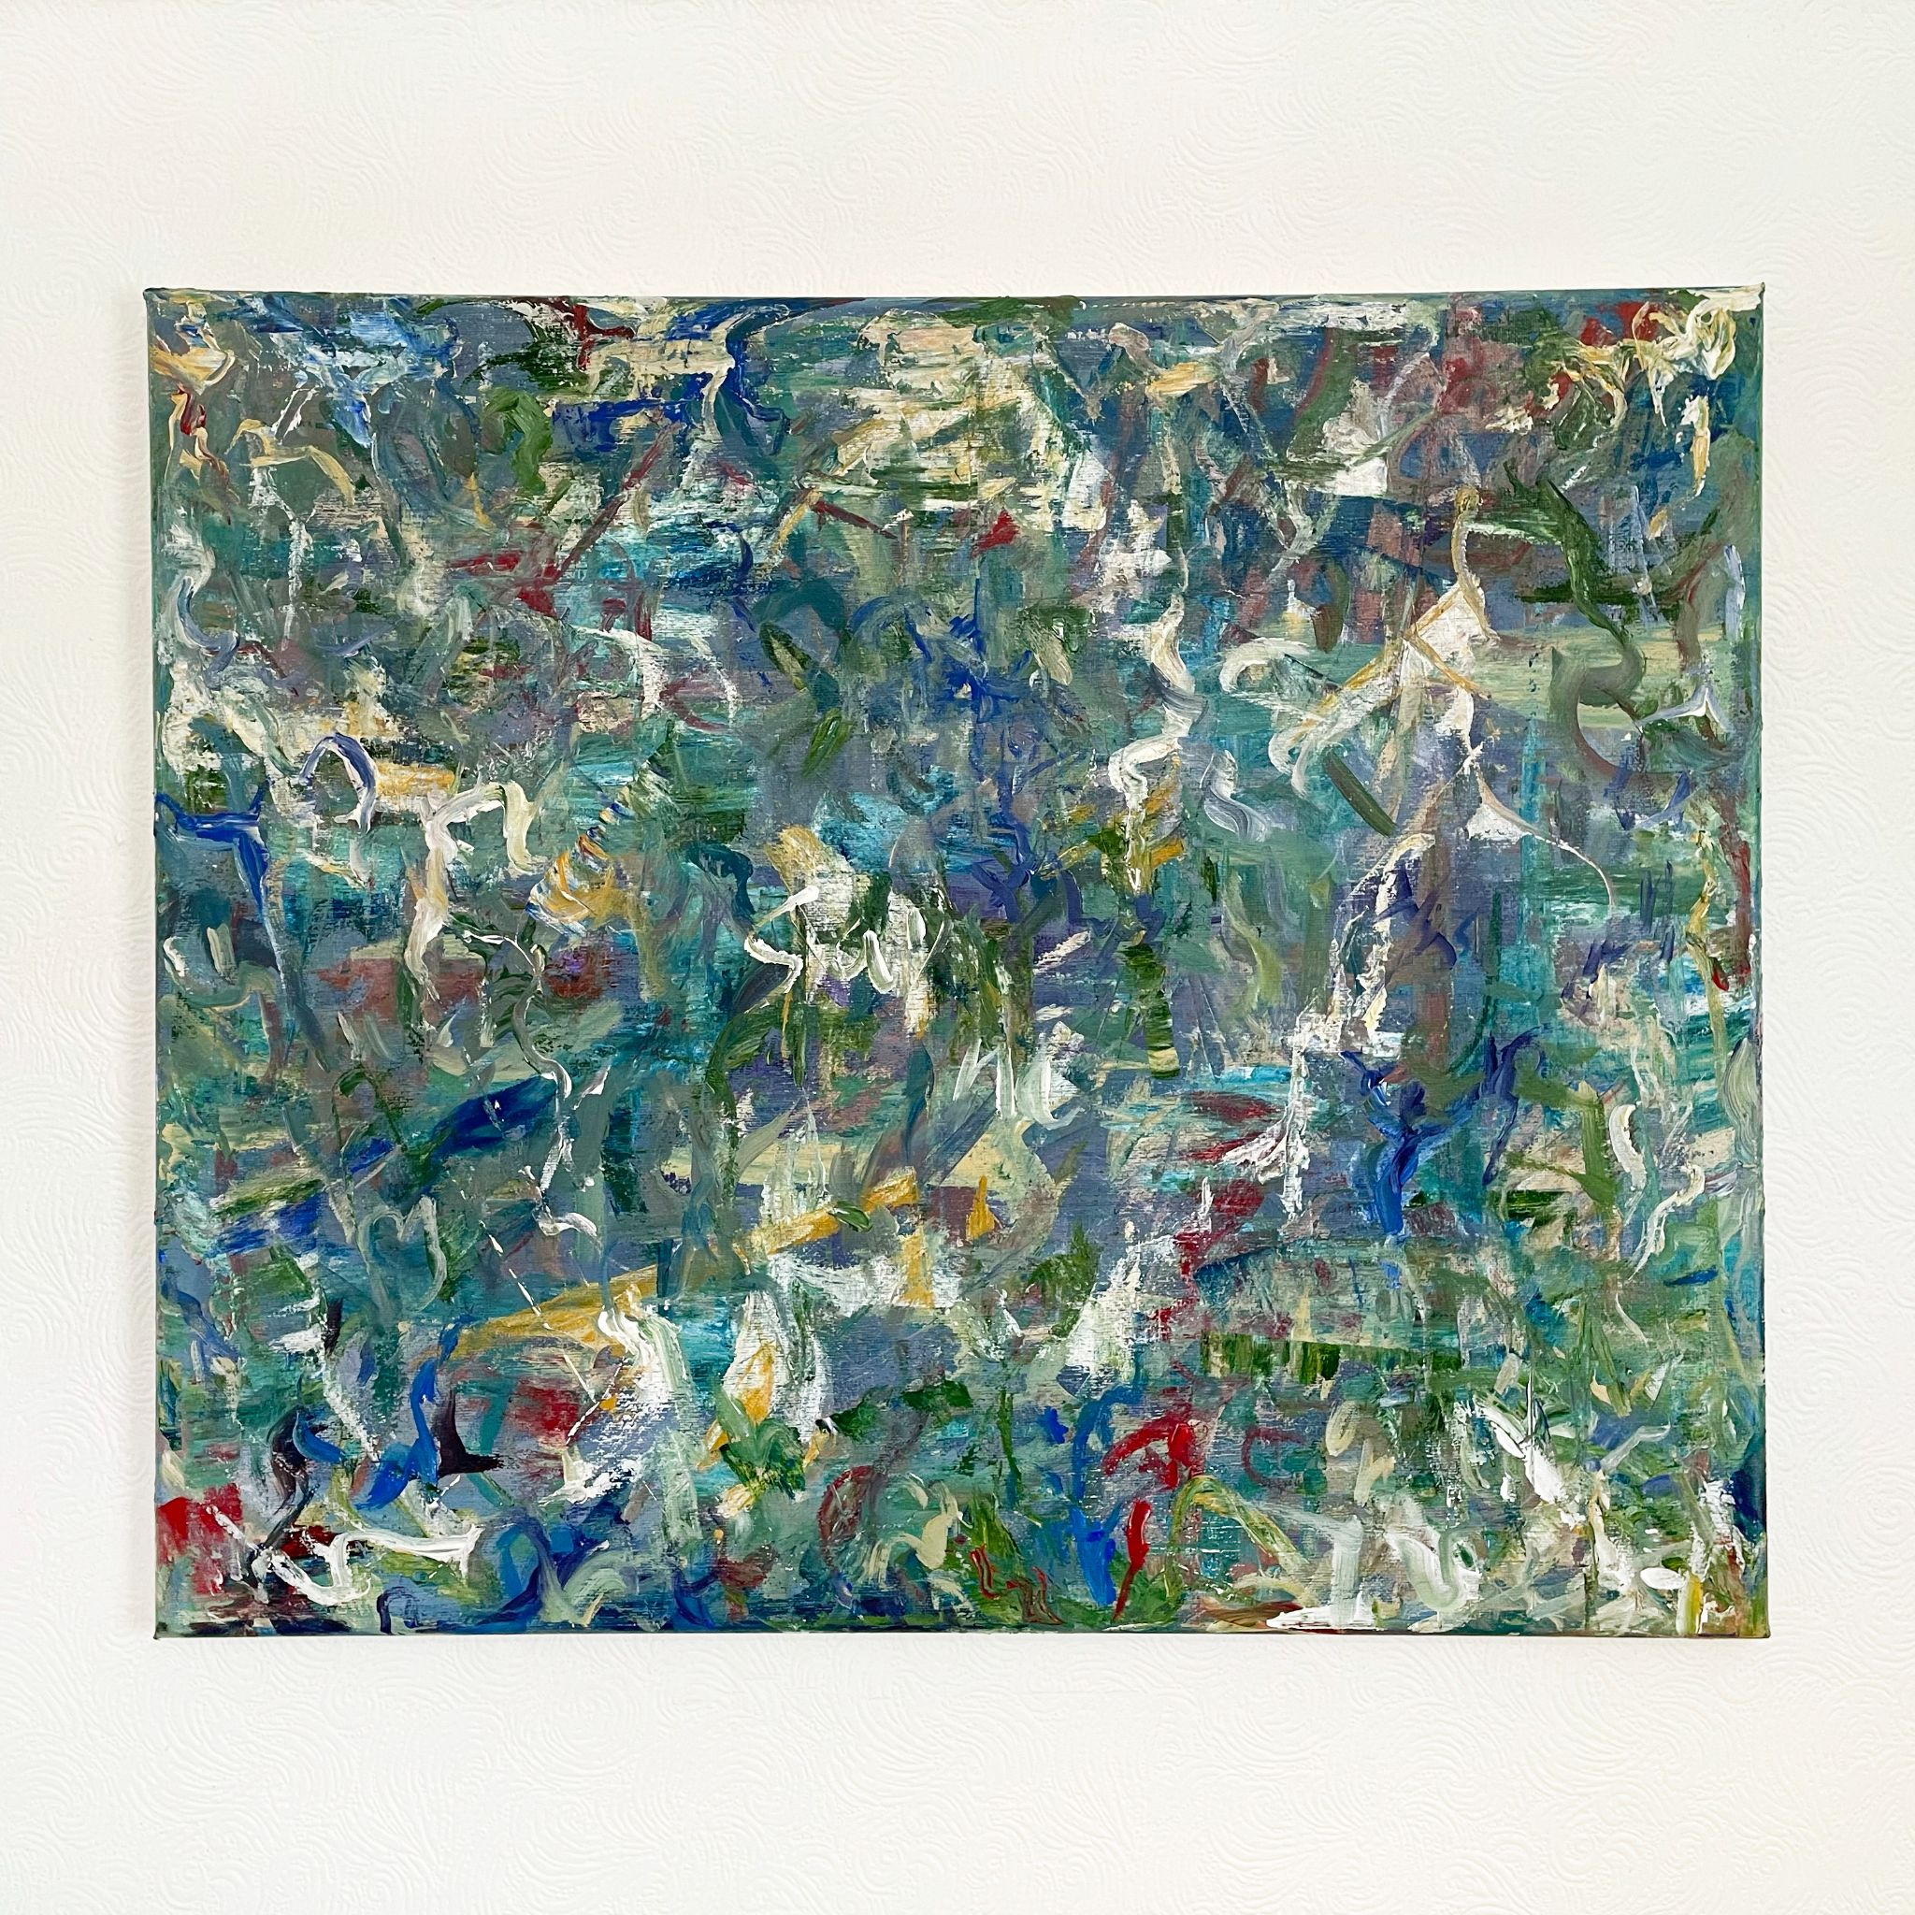
Postlapsarian Ecstasy, 2021
Acrylic on canvas
500x600mm
Angel, 2021
Acrylic on canvas
500x600mm
A Humid Summer Night, 2021
Acrylic on canvas
500x600mm

Slide 4
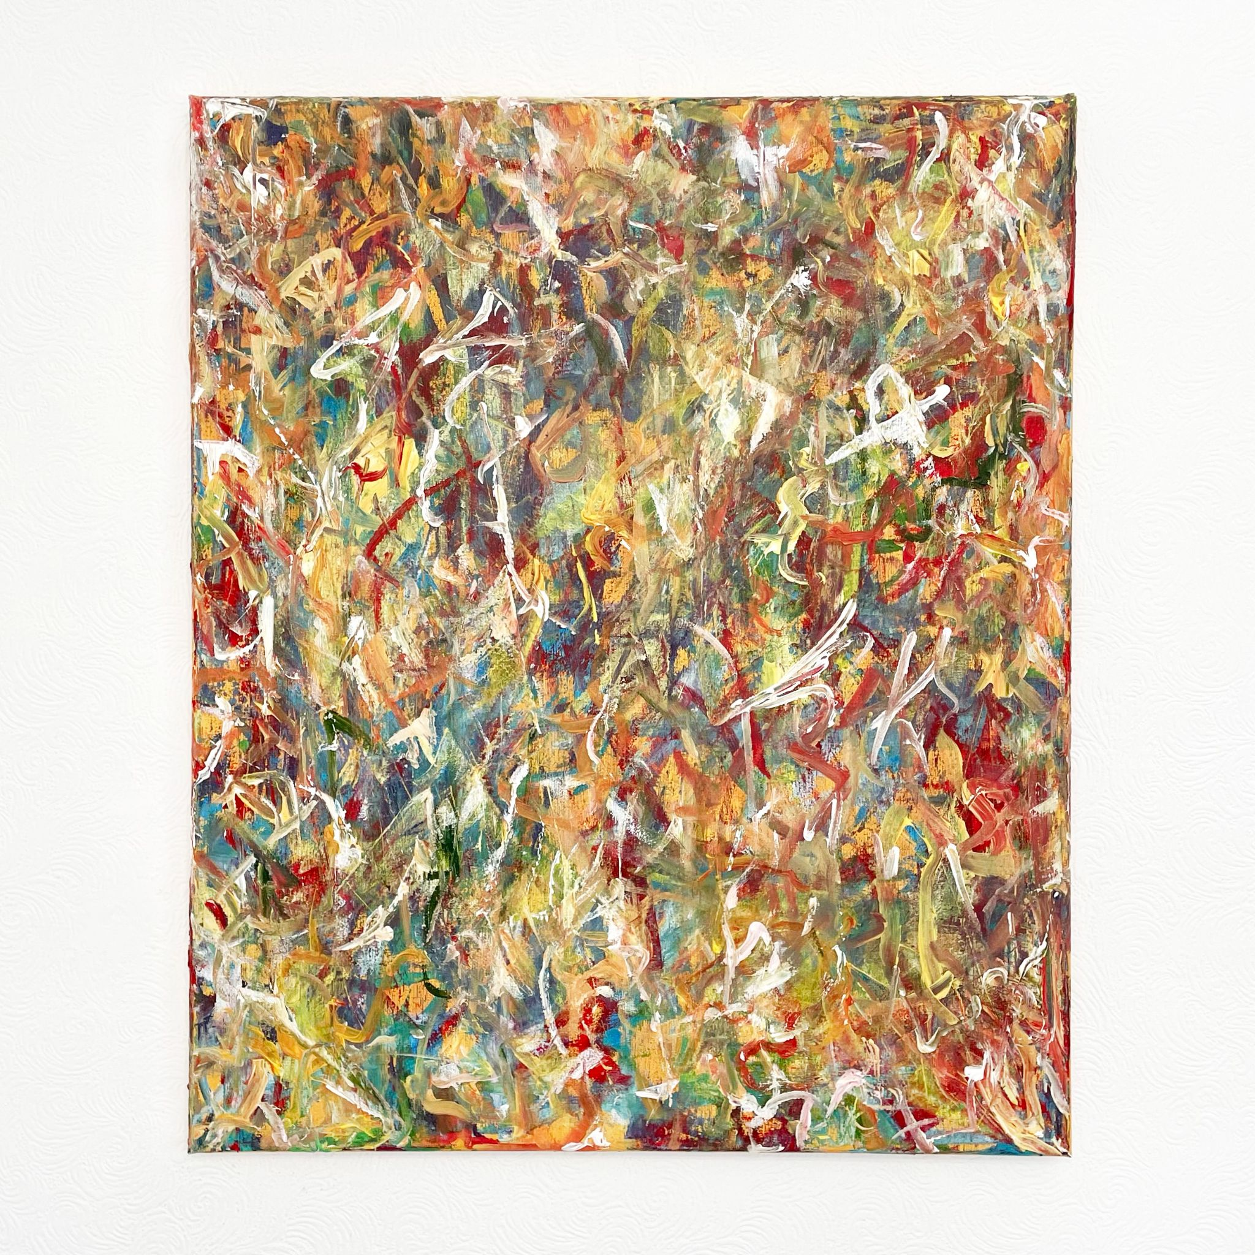
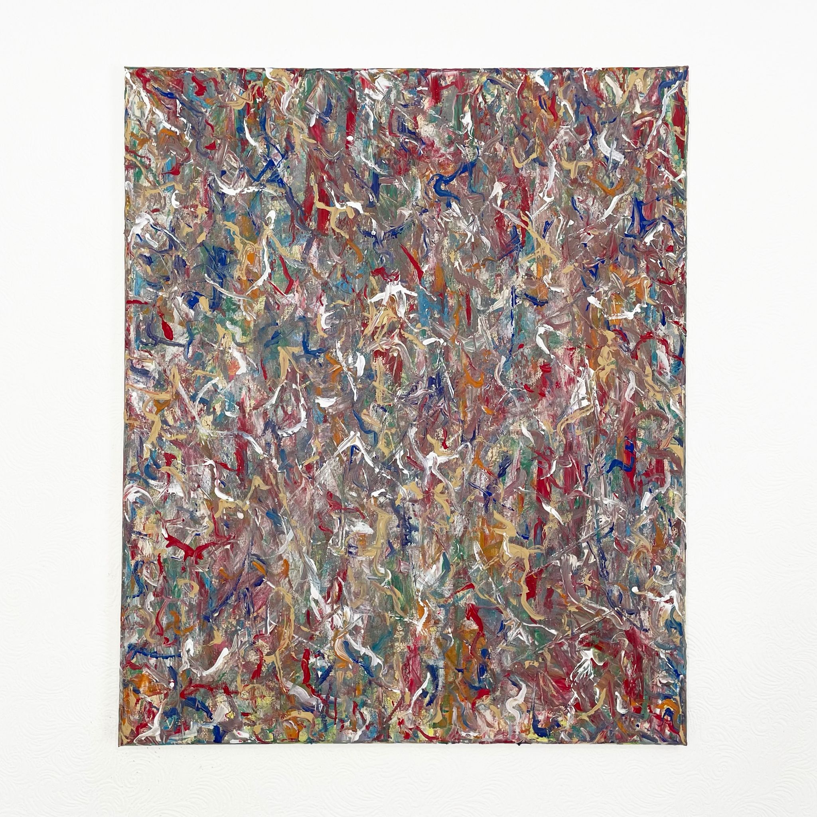
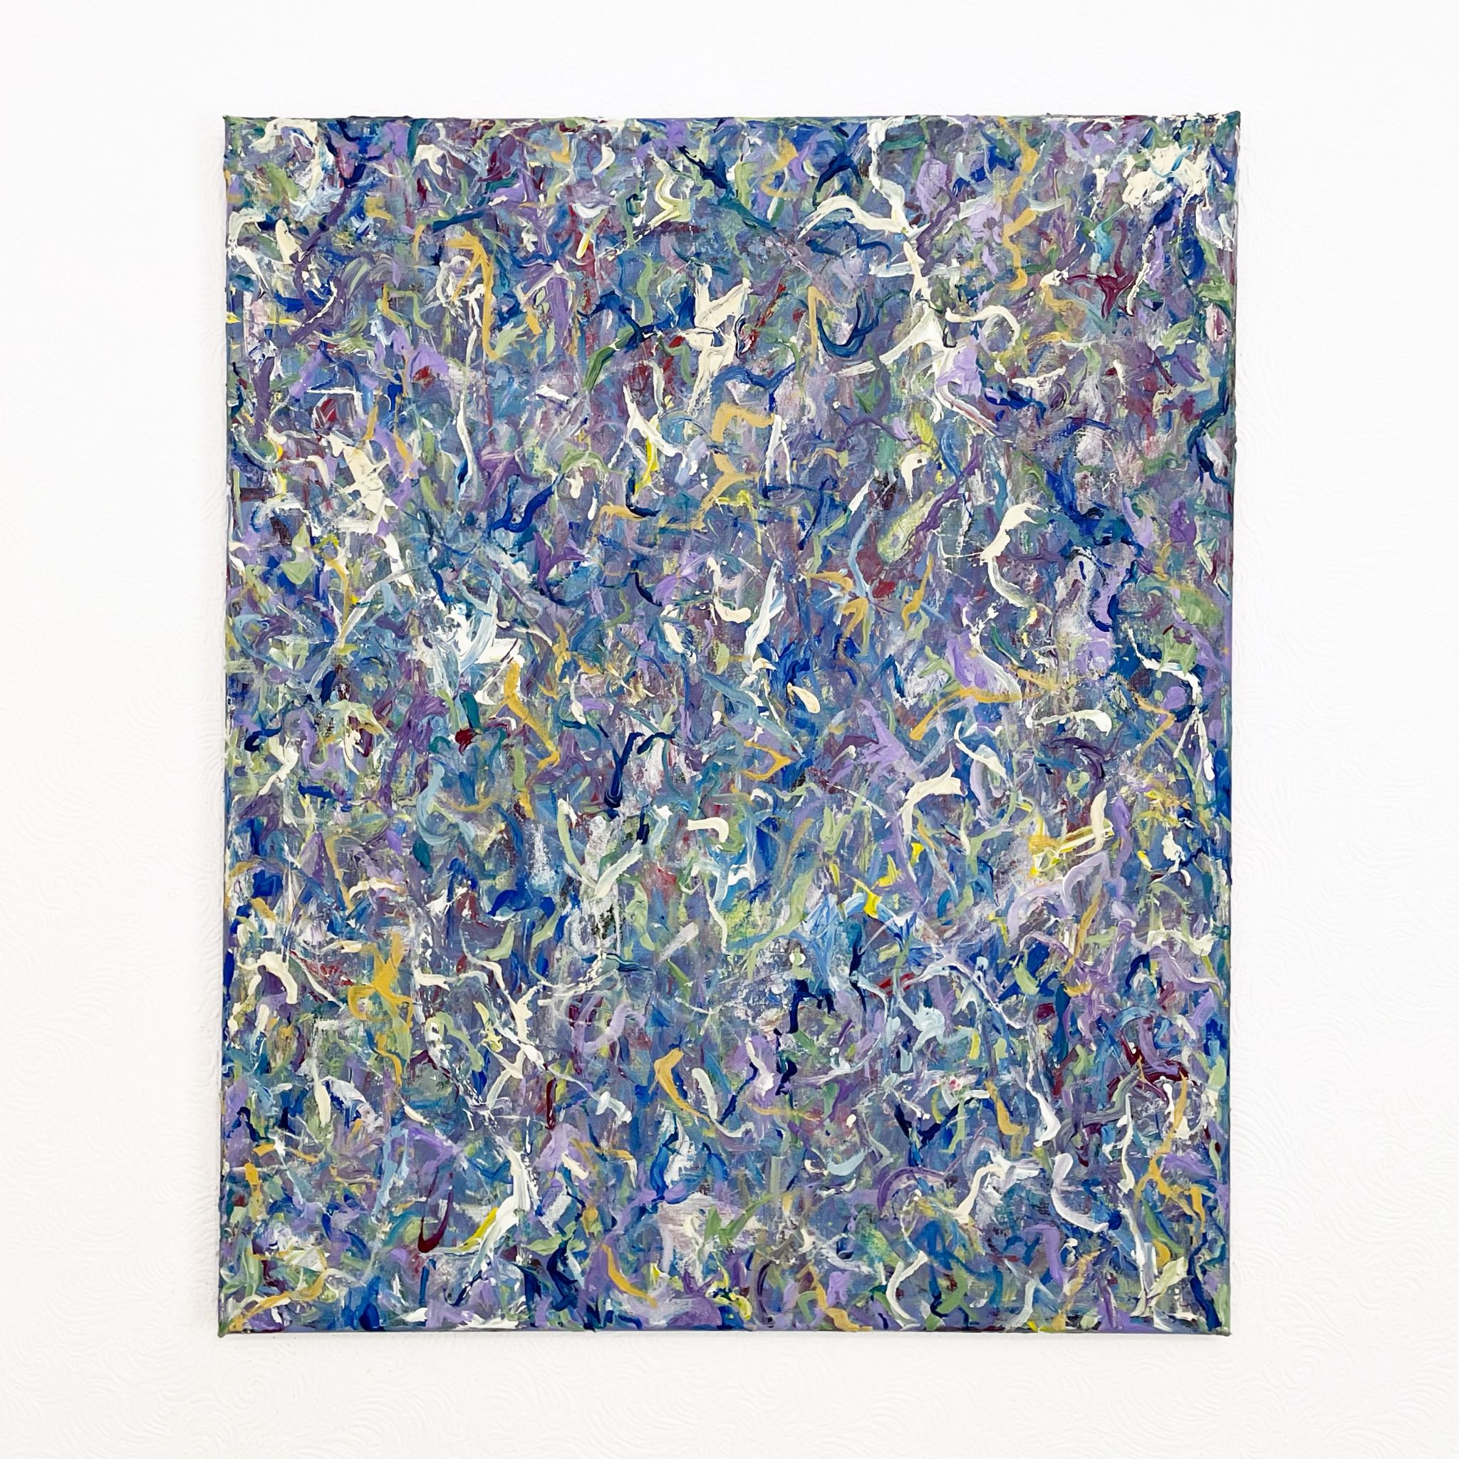
Can’t Start Anew, 2021
Acrylic on canvas
600x500mm
Too Loud a Solitude, 2021
Acrylic on canvas
600x500mm
Cyber Ocean Liquid Love, 2021
Acrylic on canvas
600x500mm

Slide 5
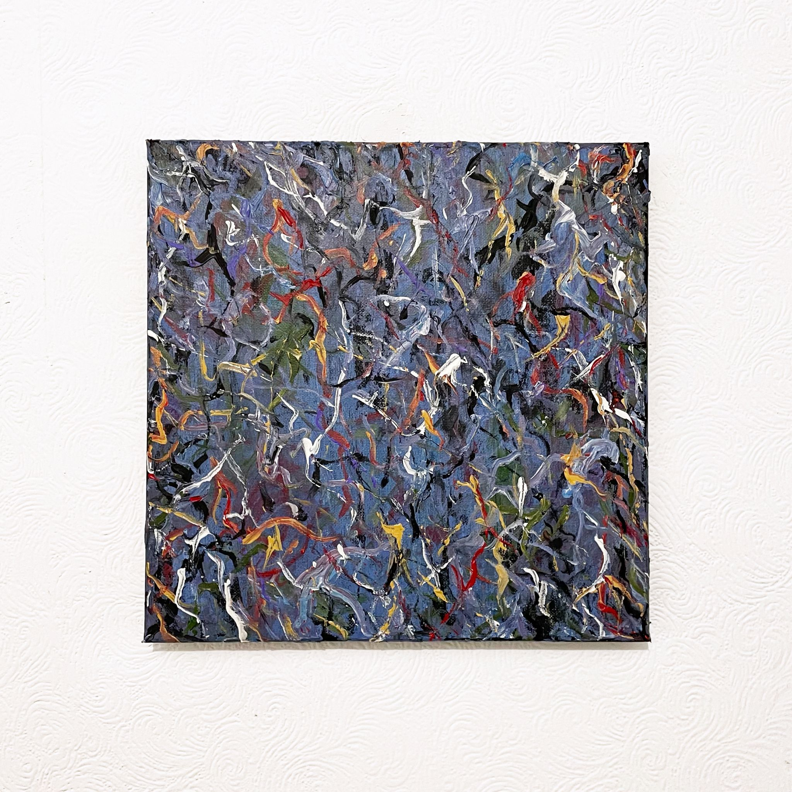
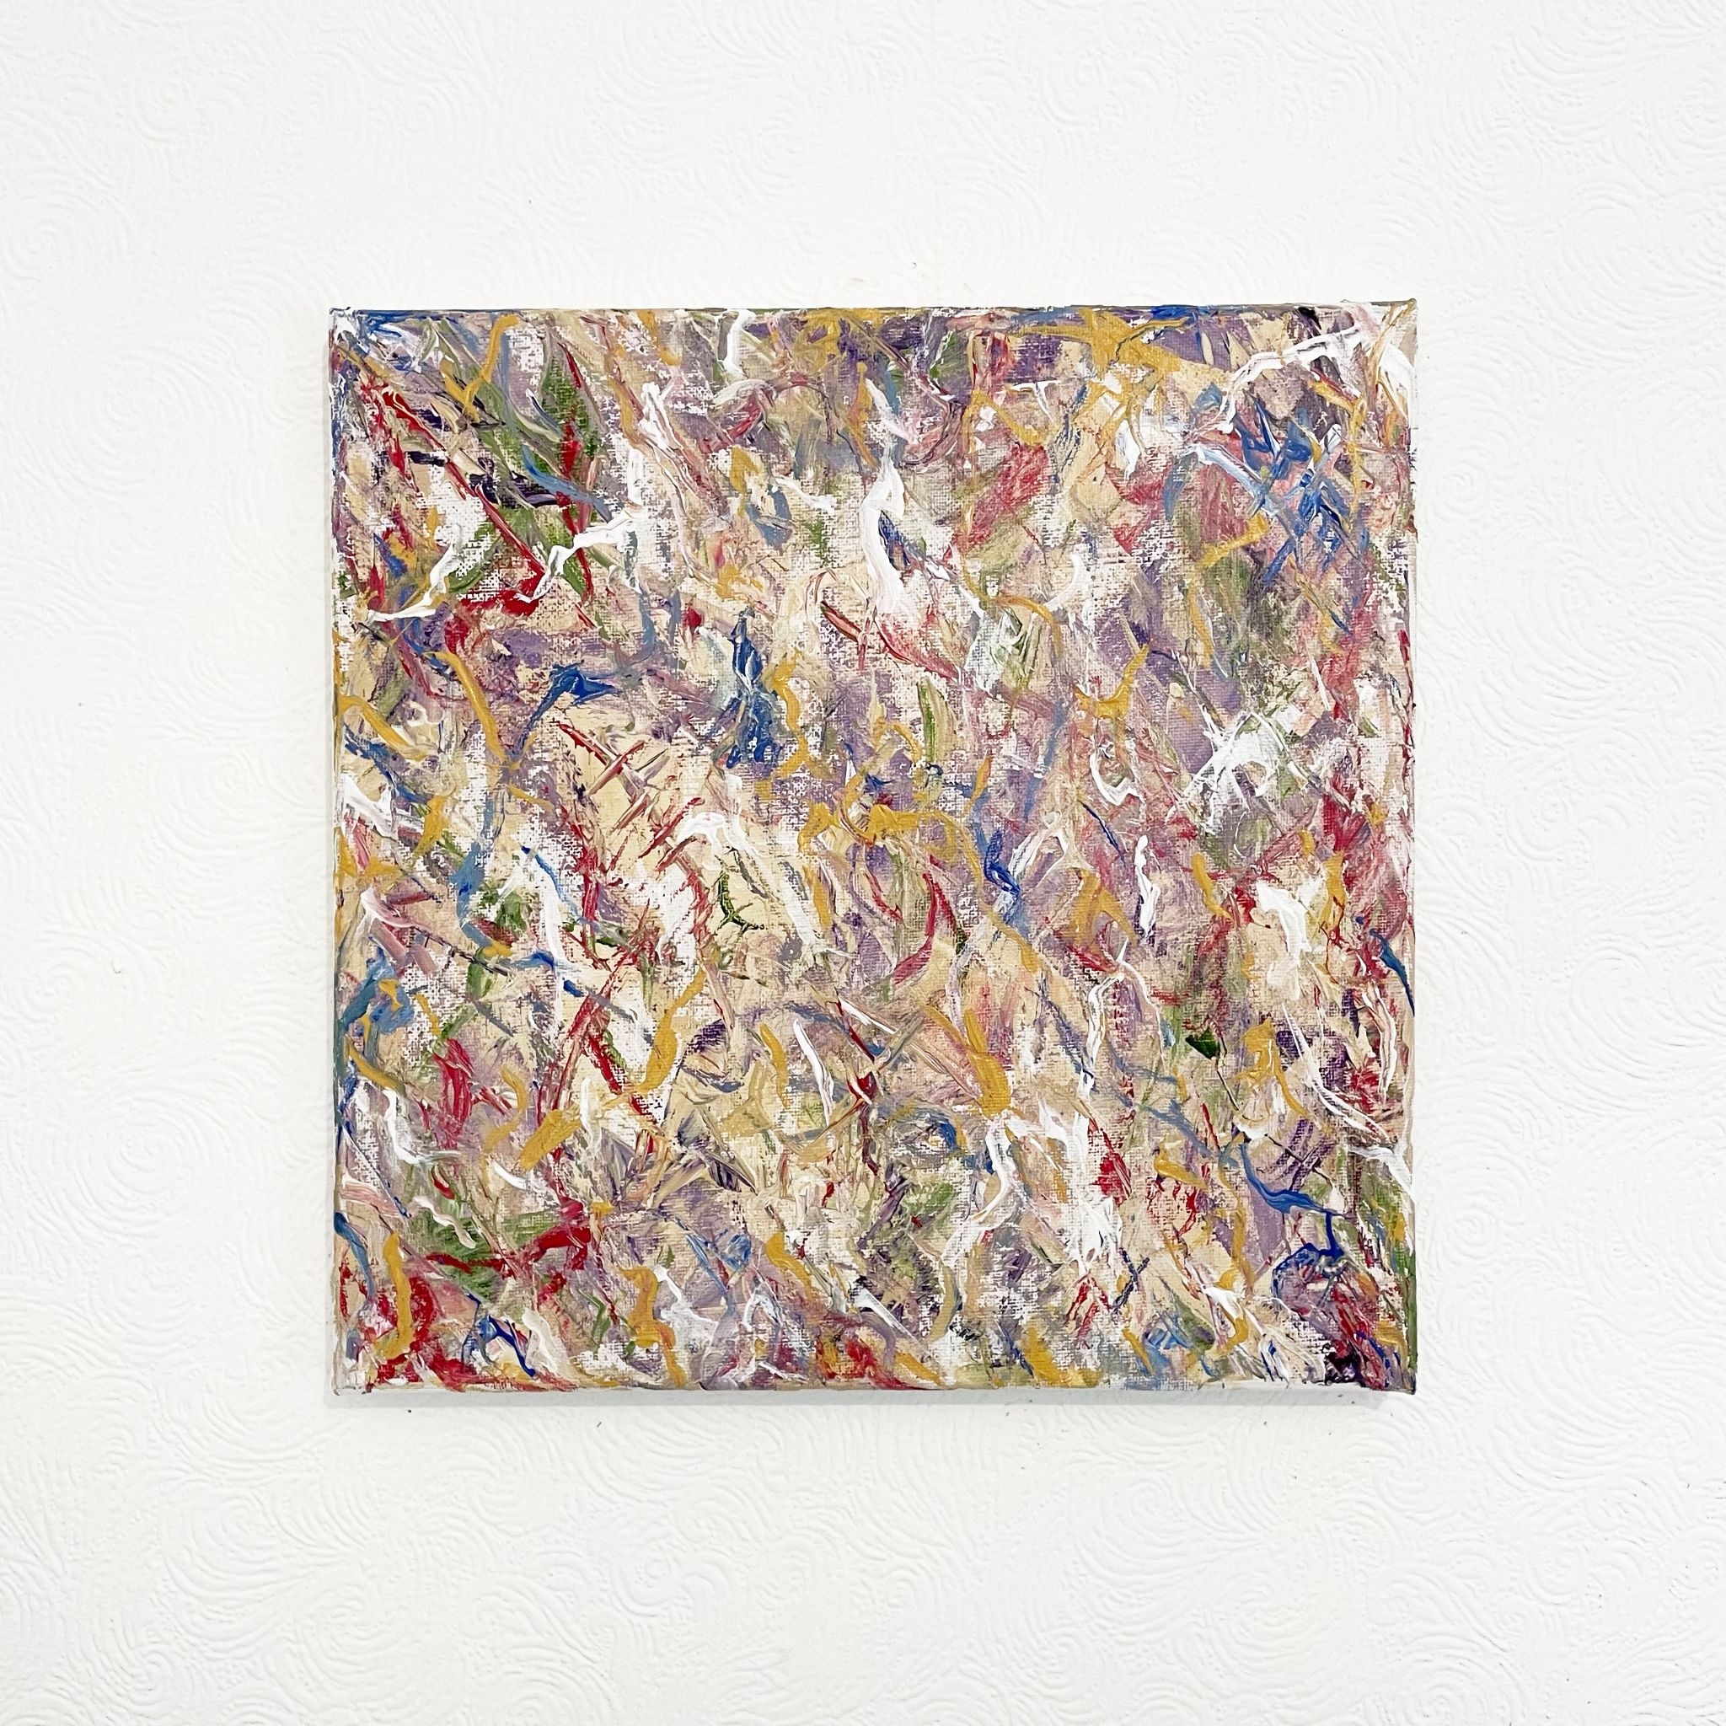
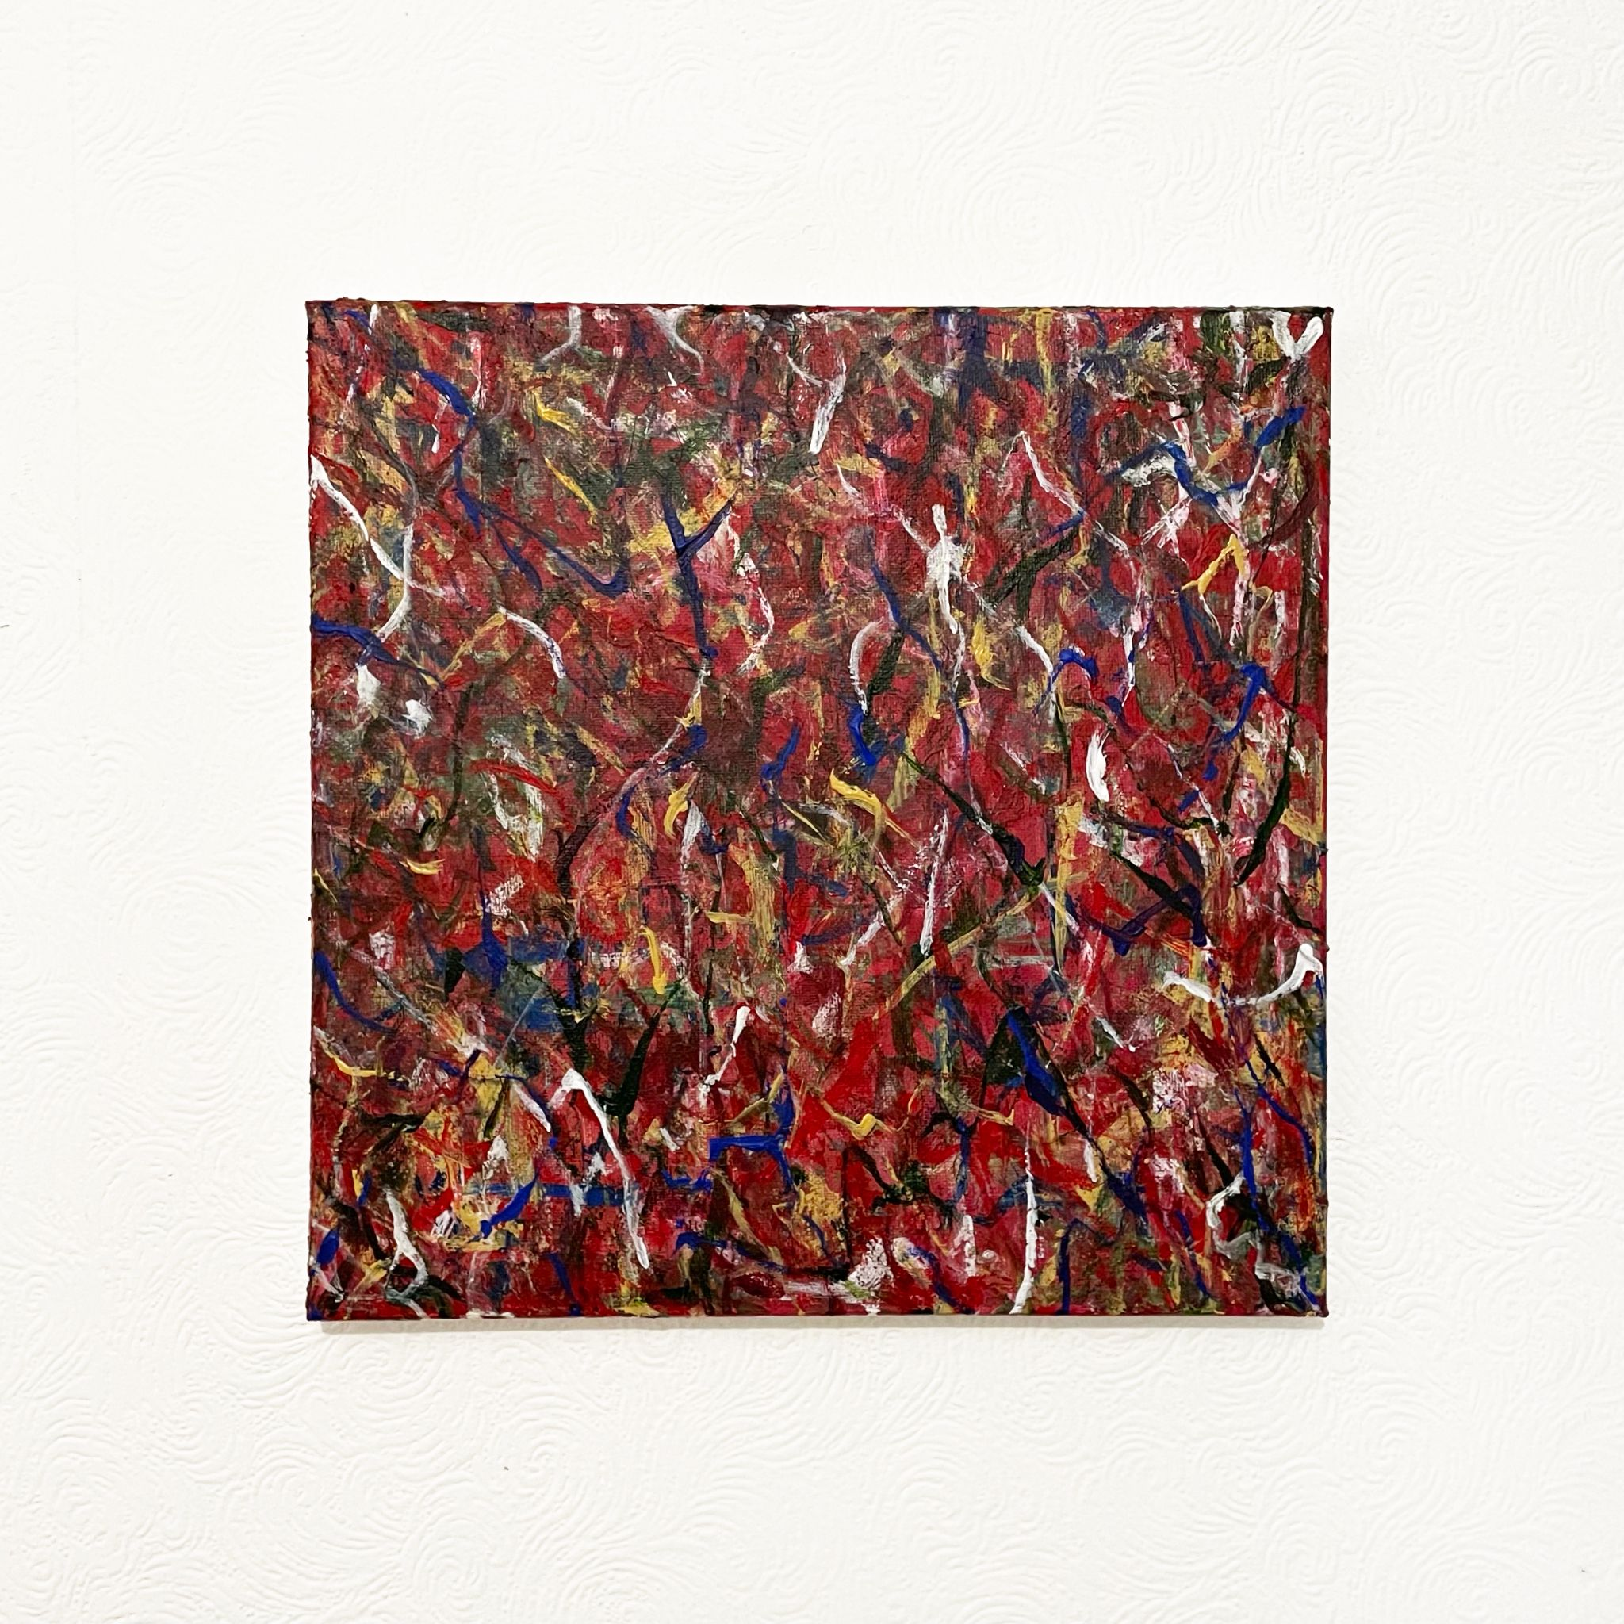
Midsummer Fairytale, 2021
Acrylic on canvas
300x300mm
Epiphany Baby, 2021
Acrylic on canvas
300x300mm
Agony, 2021
Acrylic on canvas
300x300mm

Slide 6
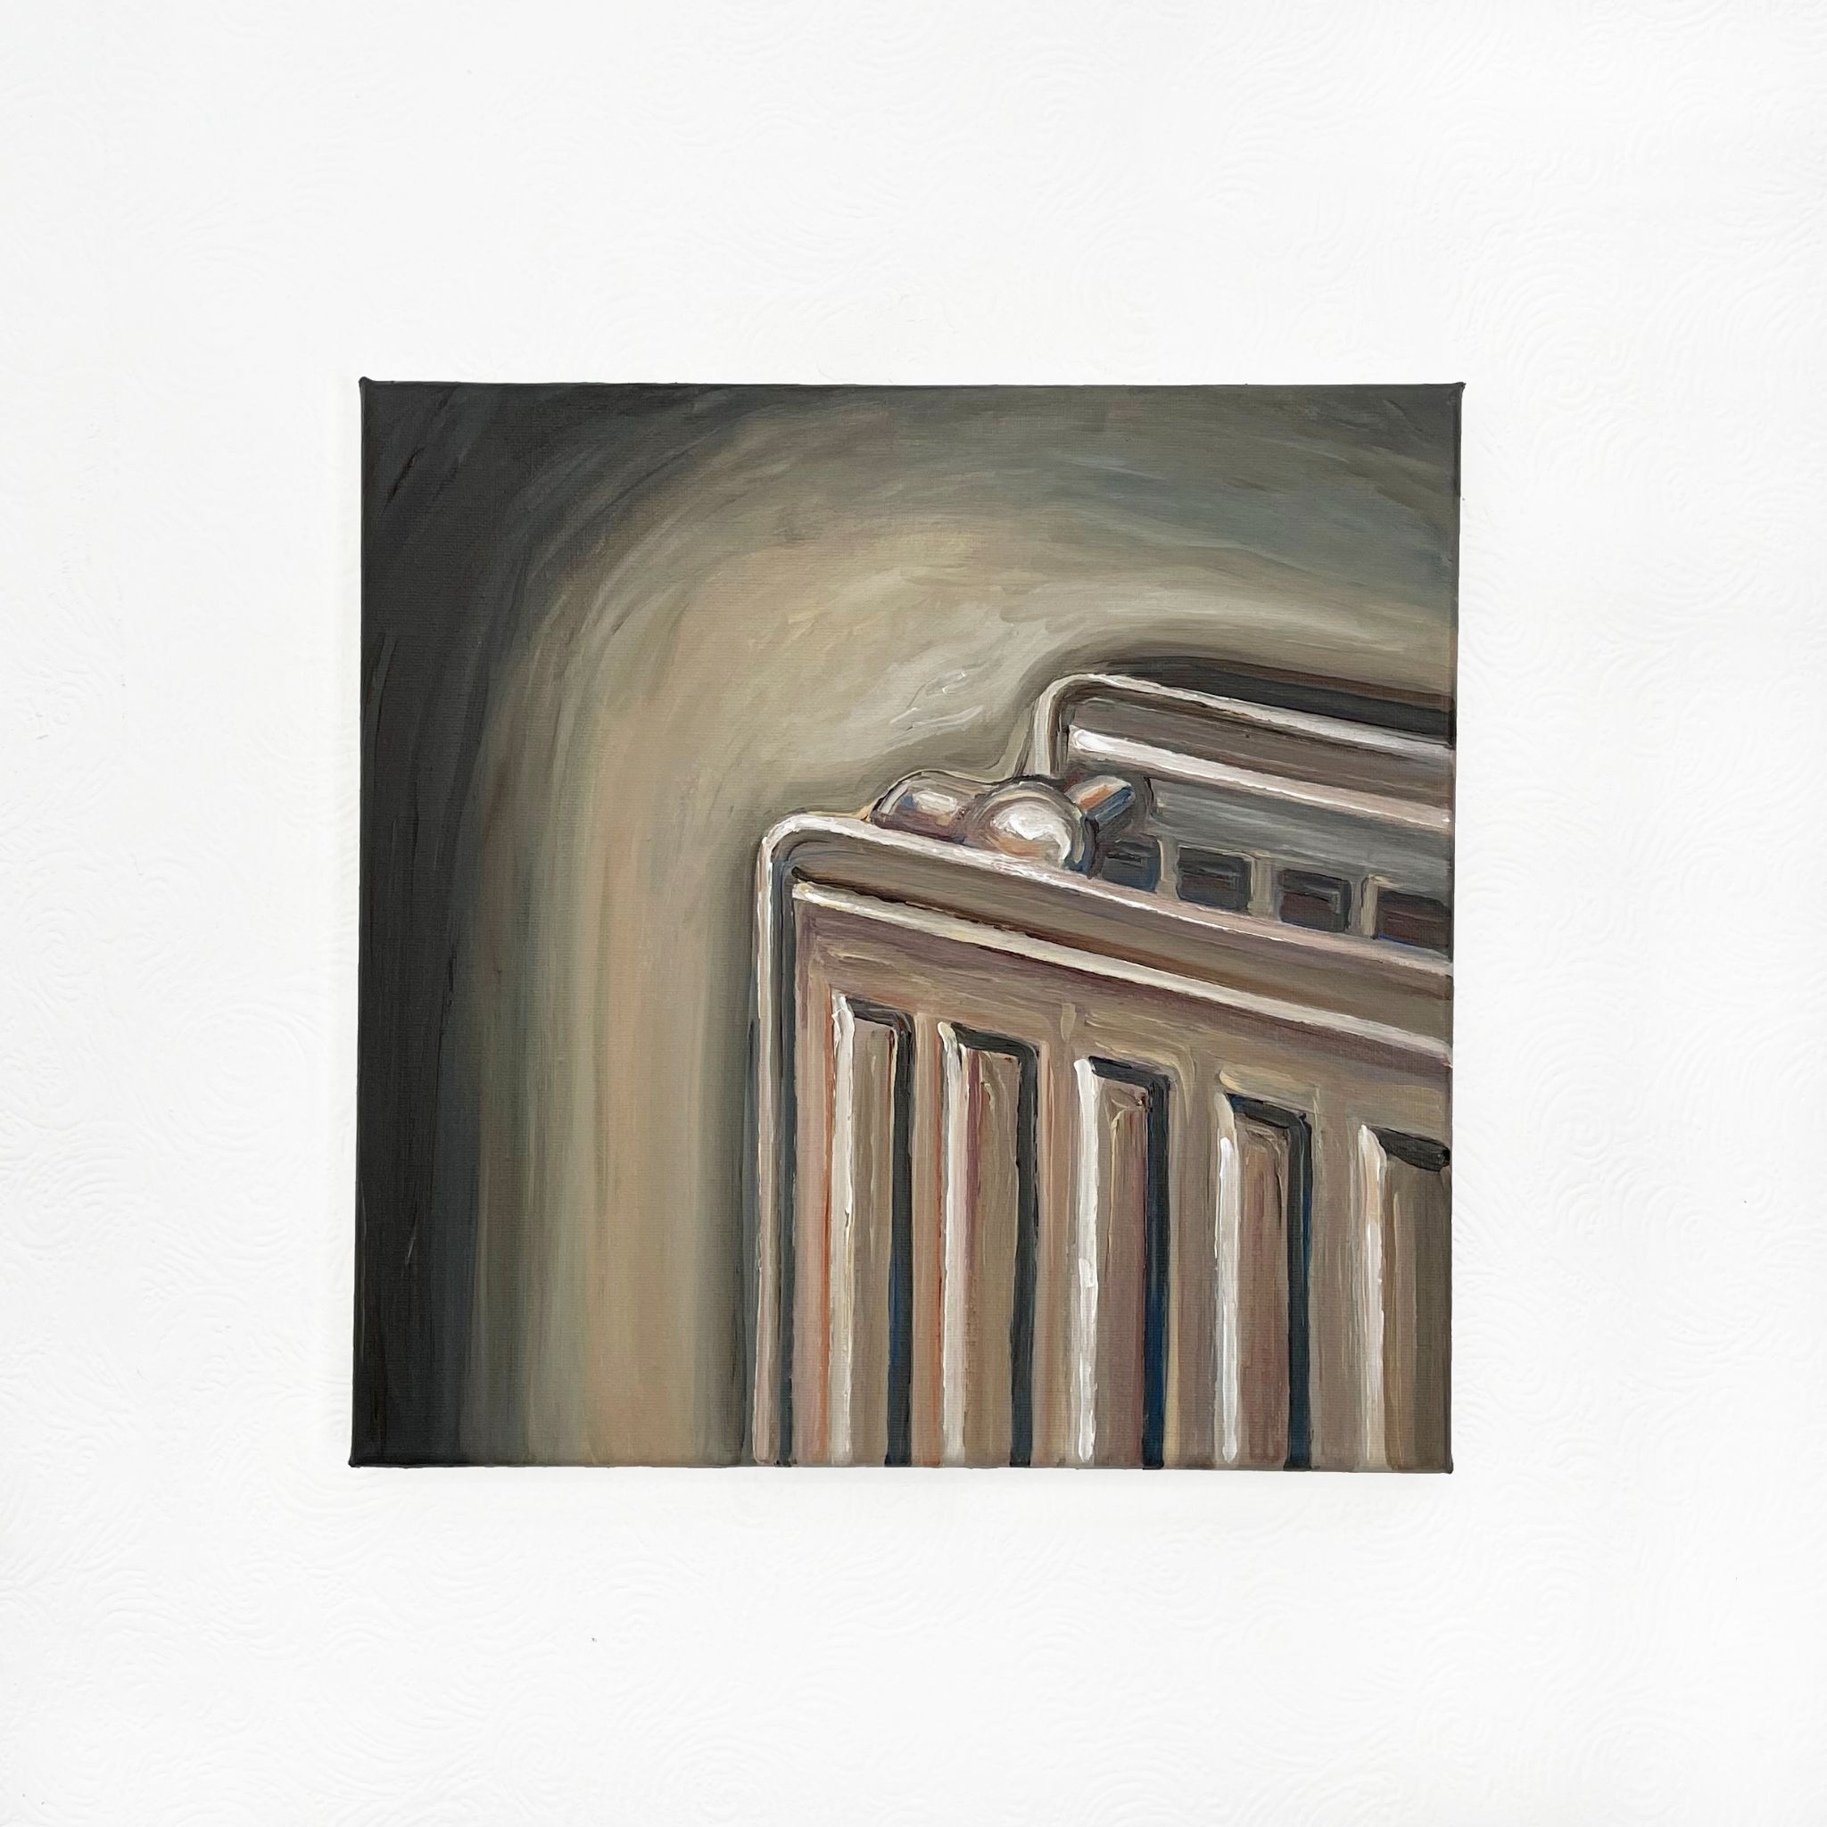
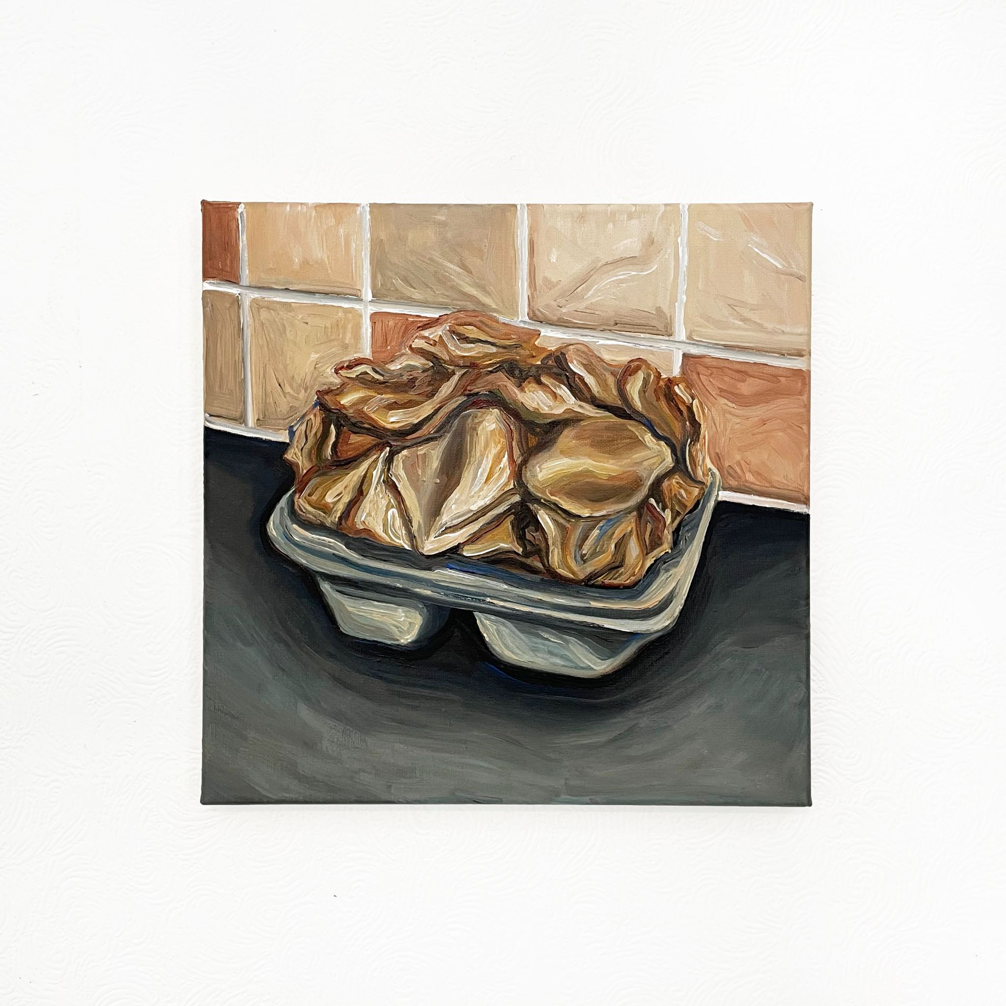
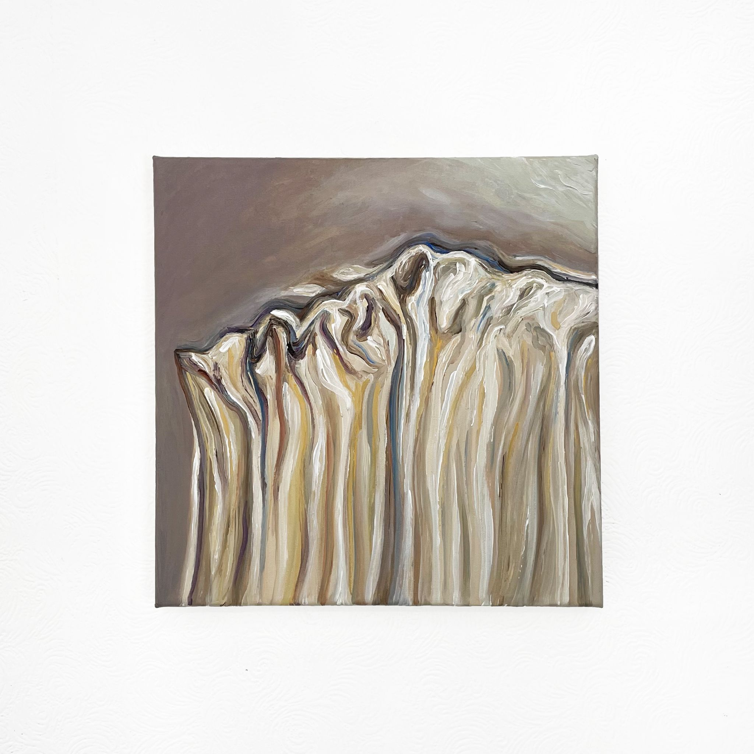
Radiator 229, 2021
Acrylic on canvas
300x300mm
Teabags 229, 2021
Acrylic on canvas
300x300mm
Curtain 229, 2021
Acrylic on canvas
300x300mm

Slide 7
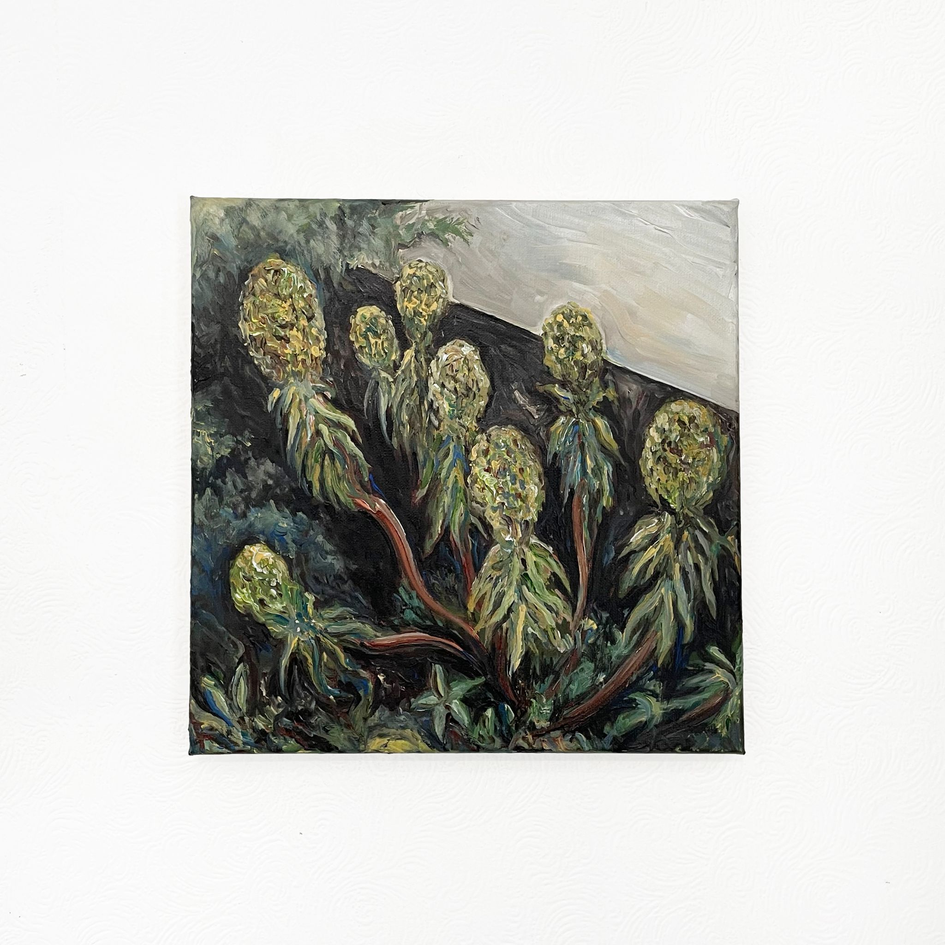
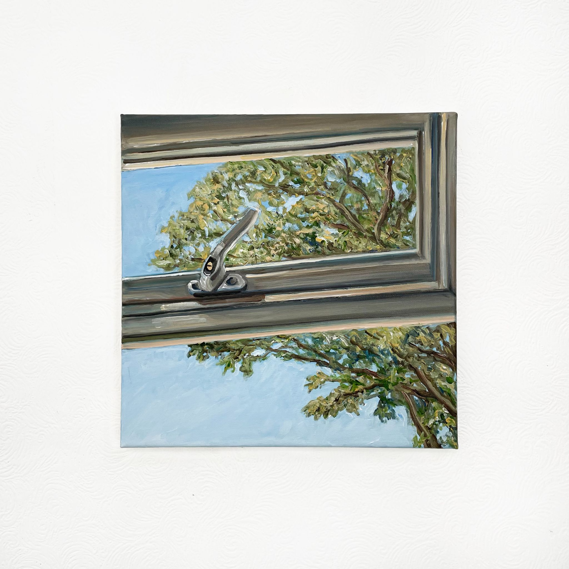
Euphorbia Bourgaeana 229, 2021
Acrylic on canvas
300x300mm
Window 229, 2021
Acrylic on canvas
300x300mm

